Slide 1

Algorithms
Lessons 5 and 6: Malaria in Kitanga

Slide 2
Objectives
In this lesson, you will learn how to:
apply the concepts of decomposition, abstraction, pattern recognition and algorithm design to a real-world problem
collect and analyse data to identify the cause of a real-world problem and suggest a solution
analyse different approaches to solving problems.

Slide 3
Objectives
Key terminology
Generalization
Decomposition
Data collection
Abstraction
Pattern recognition

Slide 4
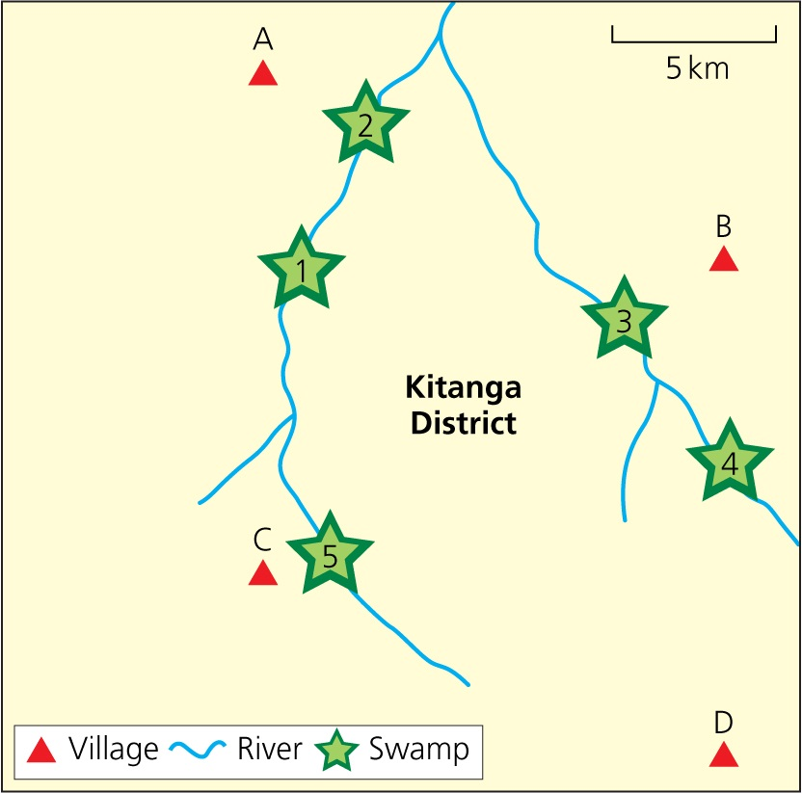
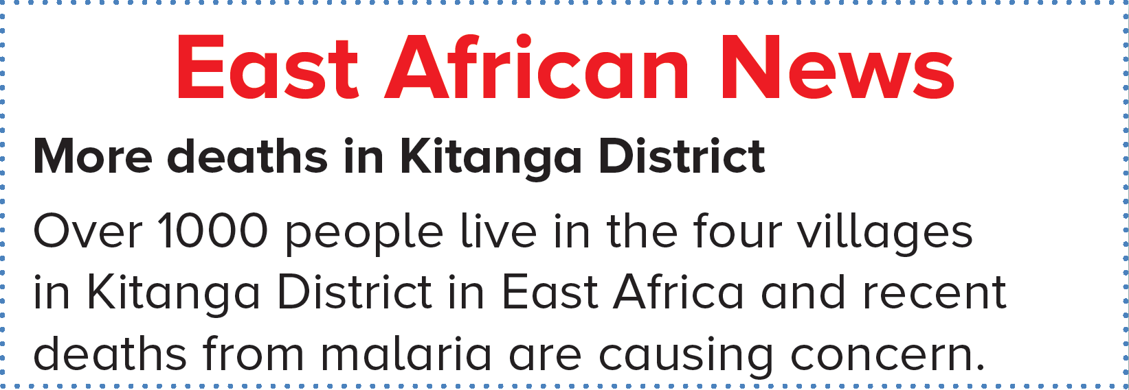
East African News
Read the front page of the East African News and look at the map of Kitanga District.

Slide 5
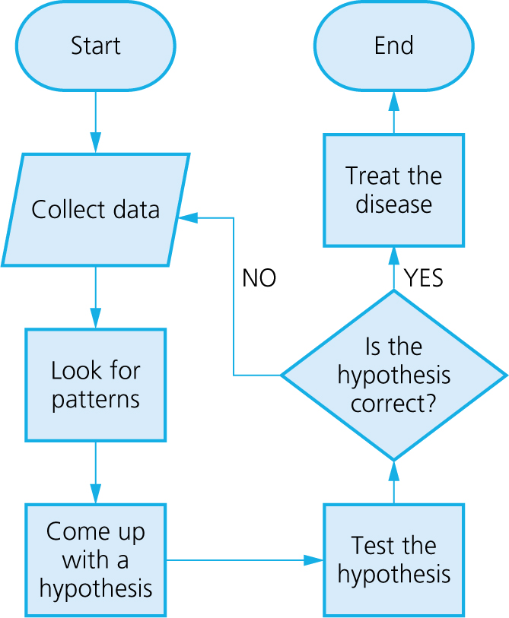
Dr Snow’s algorithm

Slide 6
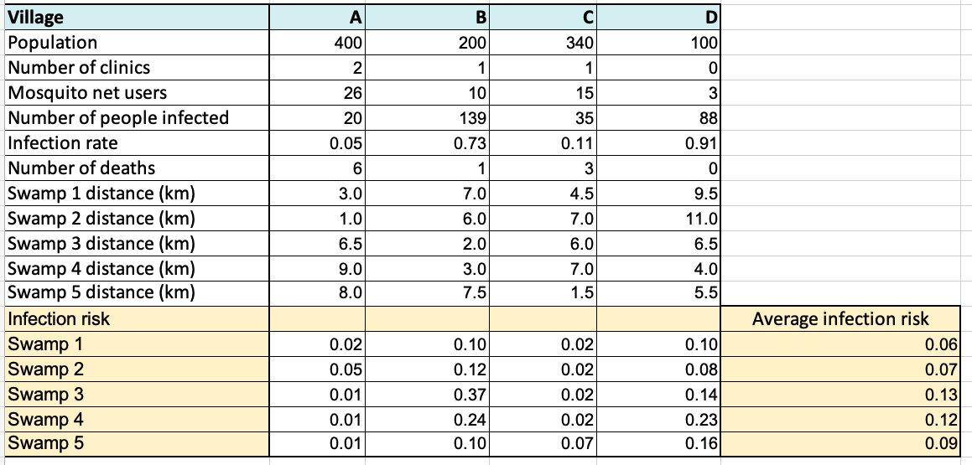
Dr Snow’s algorithm

Slide 7
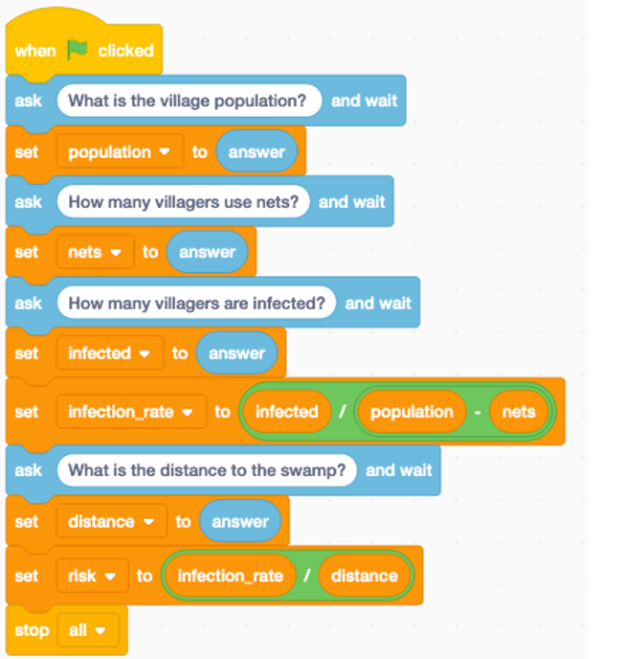
Dr Snow’s algorithm
population = 0
nets = 0
infected = 0
infection_rate = 0
distance = 0
population = int(input('What is the village population? '))
nets = int(input('How many villagers use nets? '))
infected = int(input('How many villagers are infected? '))
infection_rate = (infected/(population - nets))
distance = int(input('What is distance to the swamp? '))
risk = (infection_rate / distance)
print('The risk is:')
print(risk)

Slide 8
Generalisation
Dr Snow's algorithm is still relevant today.
When a solution to a problem – like Dr Snow's algorithm – is applied to many similar types of problems, this is known as generalisation and it is a key technique used in computing.
Computer programmers frequently borrow and adapt code written for a different but similar purpose. Generalisation makes coding much more efficient and improves productivity.

Slide 9

Activity 5.1: East African News

Slide 10
Activity 5.2: Data collection

Slide 11
Activity 5.3: Abstraction

Slide 12
Activity 5.4: Pattern recognition

Slide 13
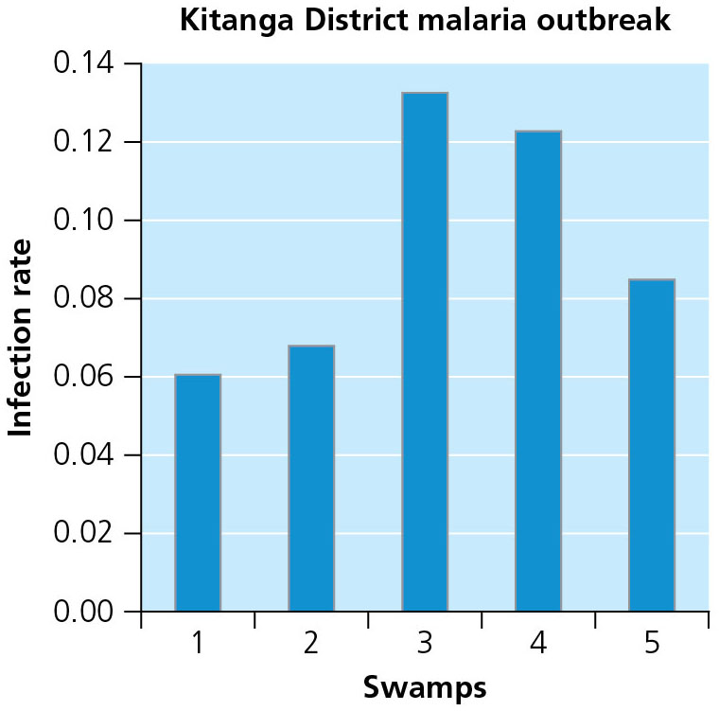
Which swamp should be sprayed?

Slide 14
Activity 5.5: Meet the Potato Heads

Slide 15
Activity 5.6: Infection risk app

Slide 16
Reflection
Name three things you have learnt during this module that you did not know before.
Name two things you would like to know more about.
Will you apply the computational-thinking approach to problem solving when you have problems of your own to solve in the future?

